Slide 1
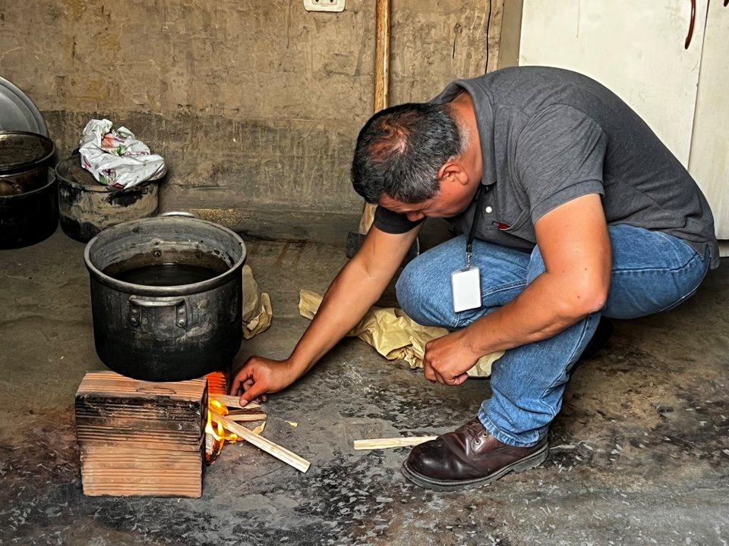
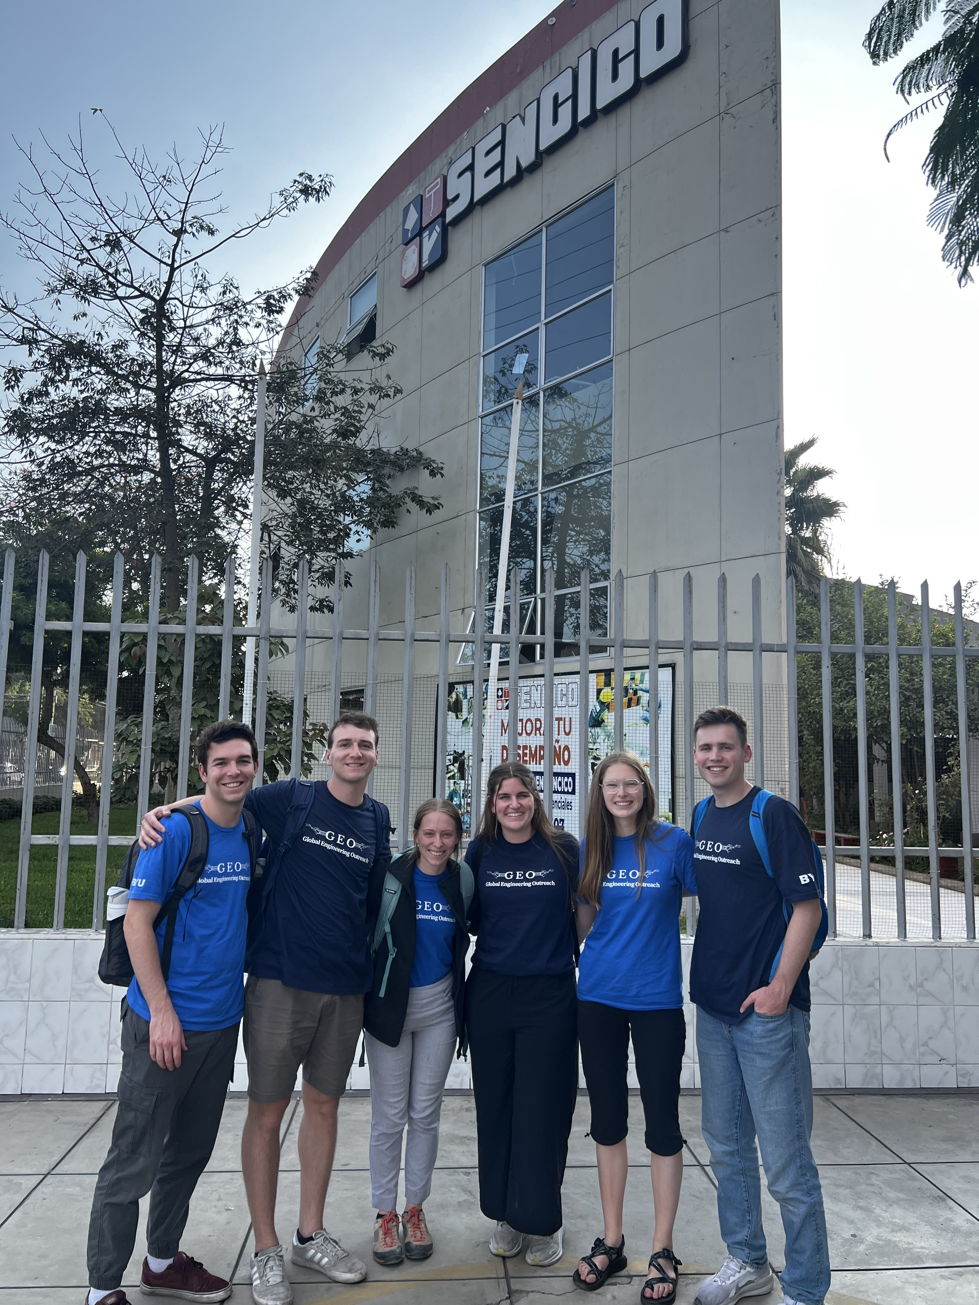
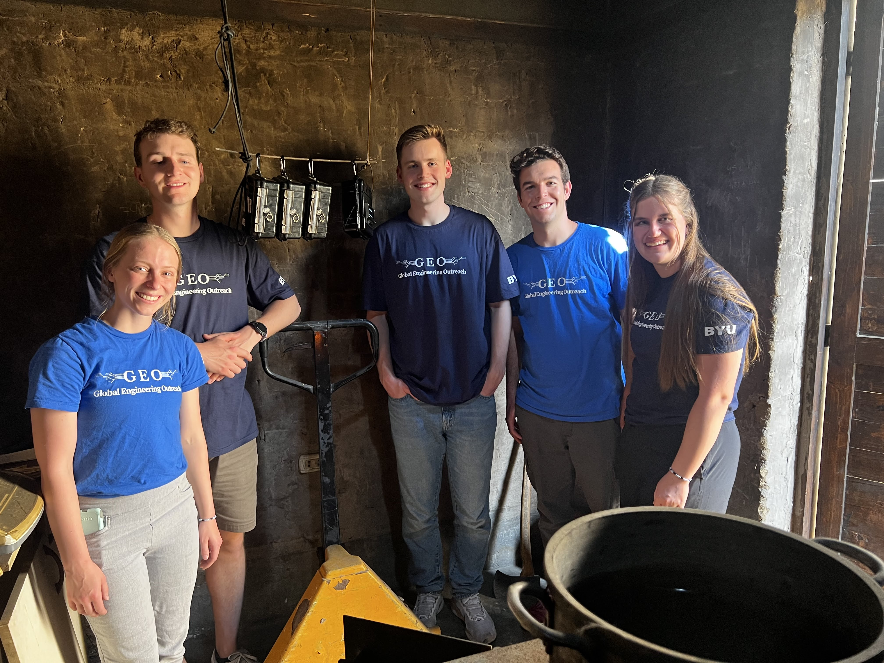
Sensational Cookstove
Sensor
2024-2025
Pablo starting the fire to simulate a cooking environment to test the sensors
Sensors hanging on wall after our test with SENCICO
Curtis Covington, Taylor Cannon, Corrine Jackson, Jamie Frei, Makayla Larsen, and Adam Wengreen (From left to right)

Slide 2
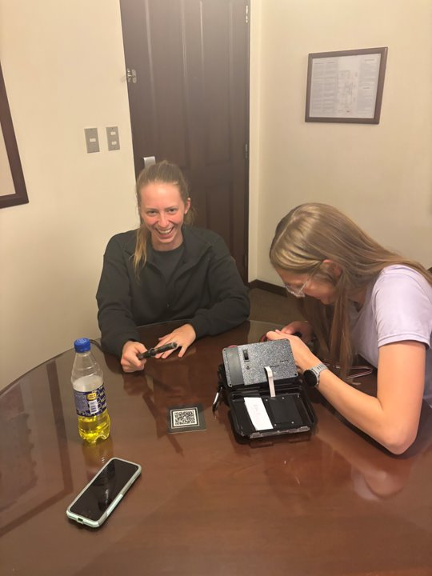
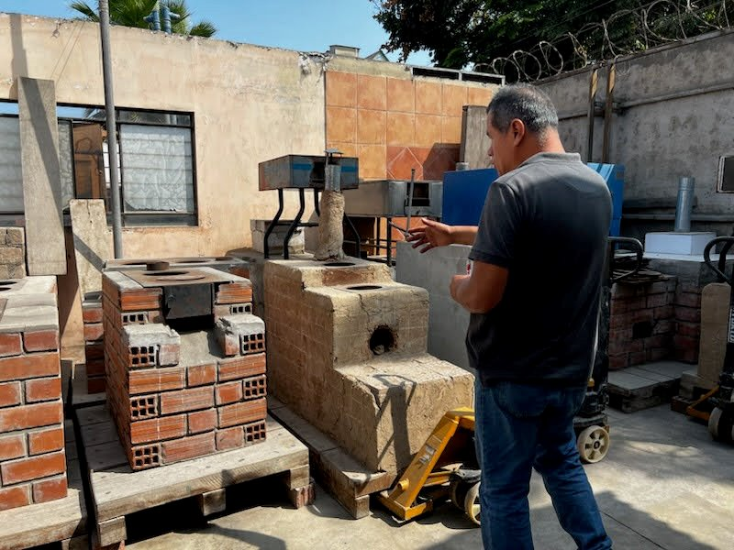
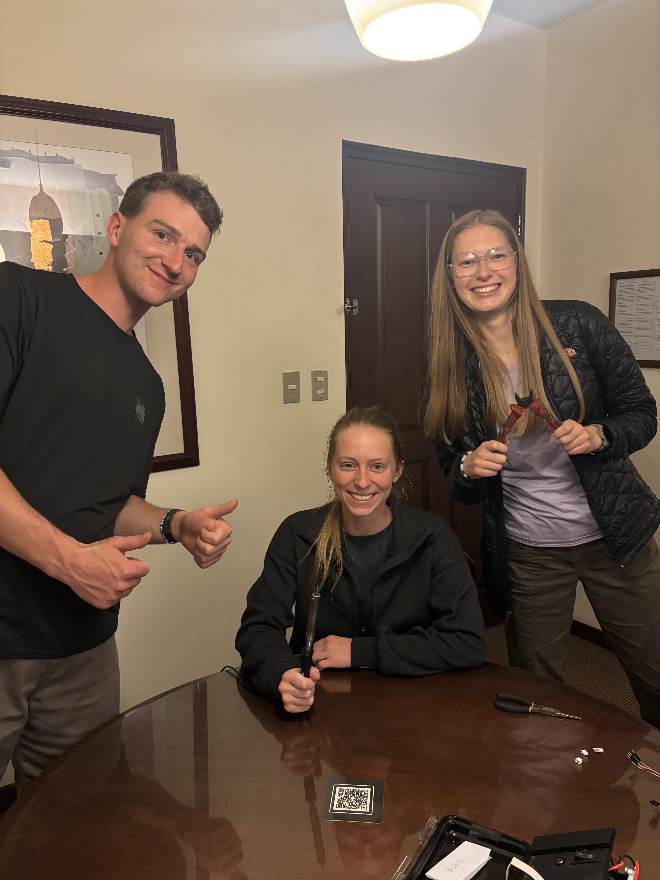
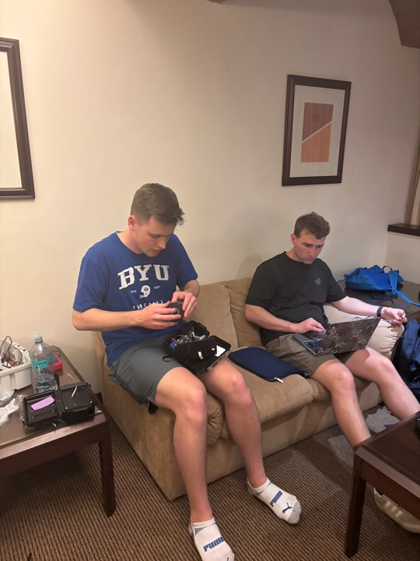
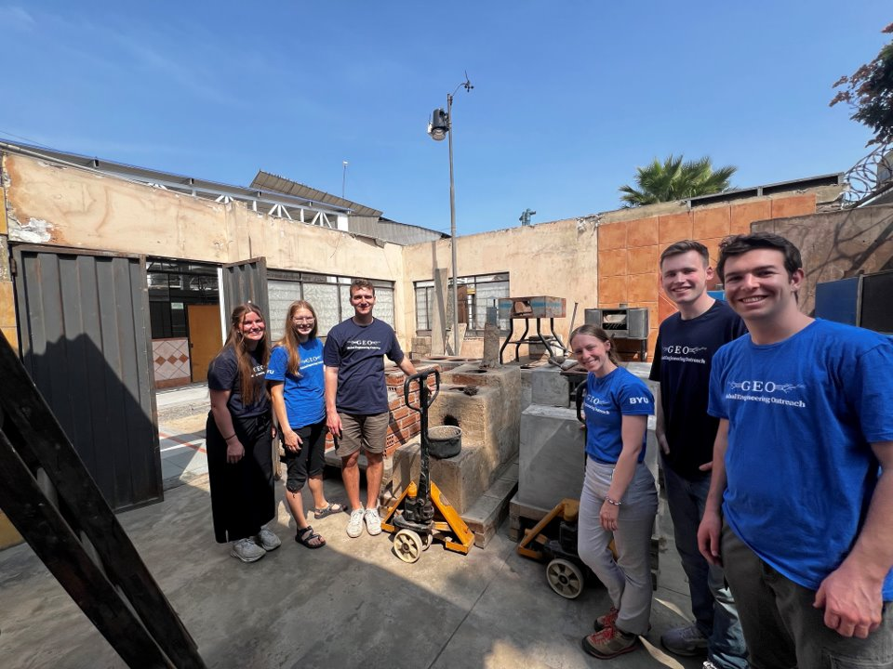
Cookstoves
at
SENCICO
Last minute preparations in the hotel included finalizing the calibration and code as well as fixing the wiring to ensure durability.
Pablo taught us about the variety of cookstoves and their ventilation systems. There are multiple designs to reduce the toxic smoke from poor fuel sources in the kitchen.

Slide 3
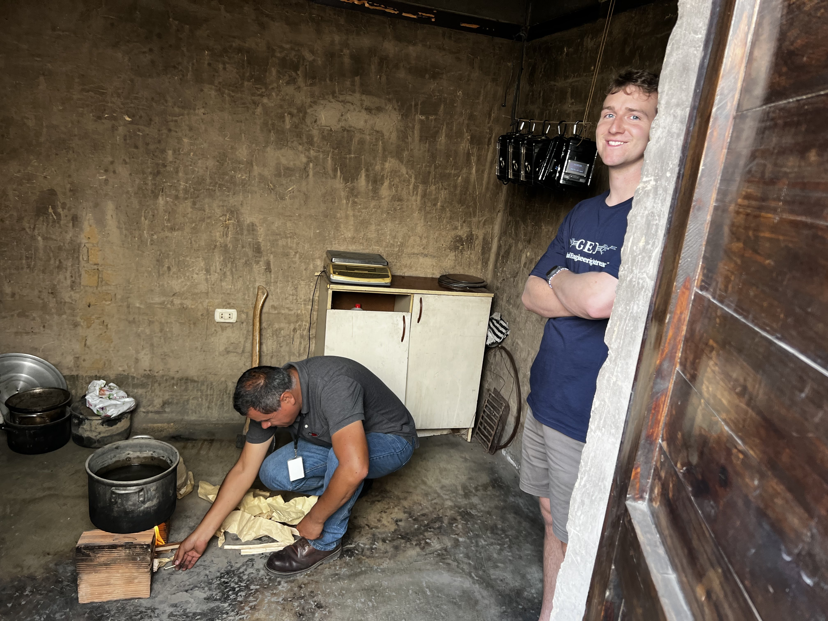
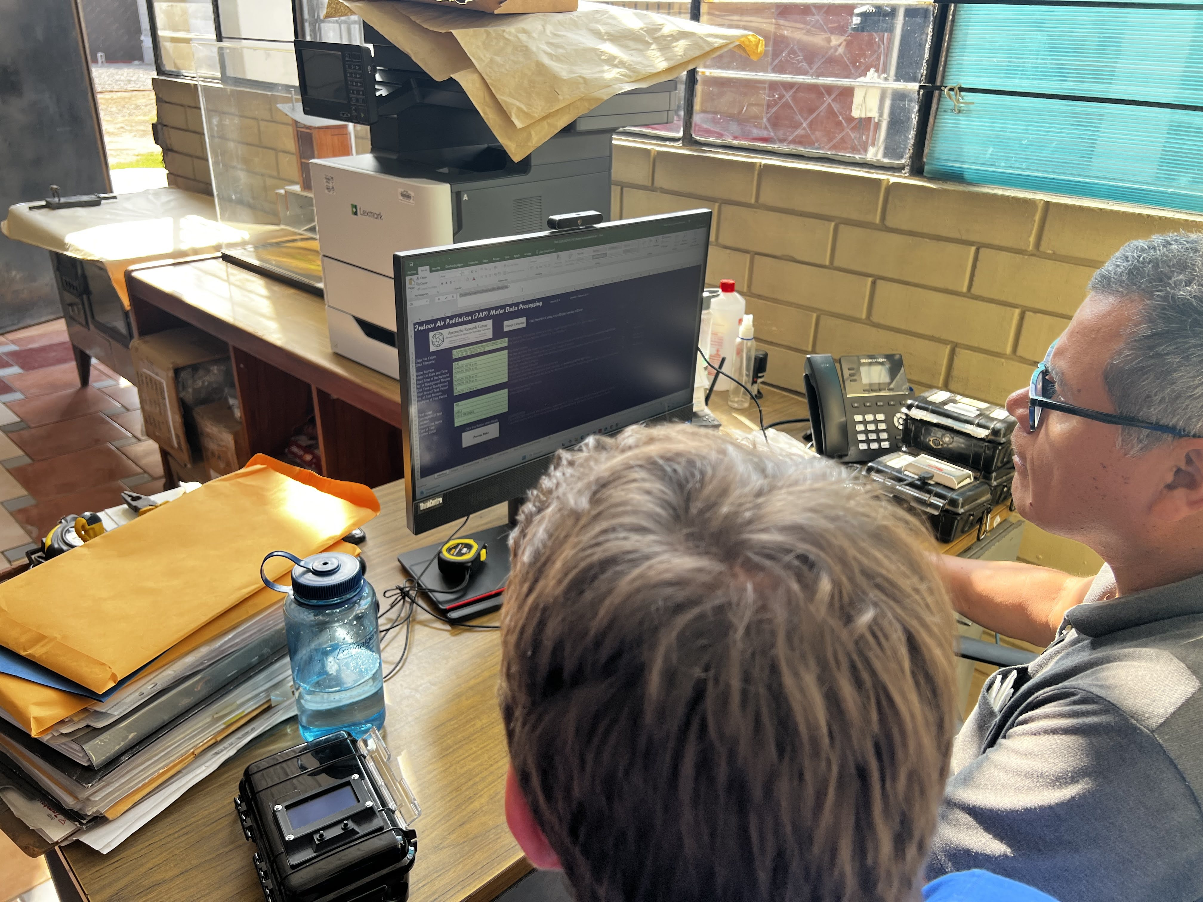
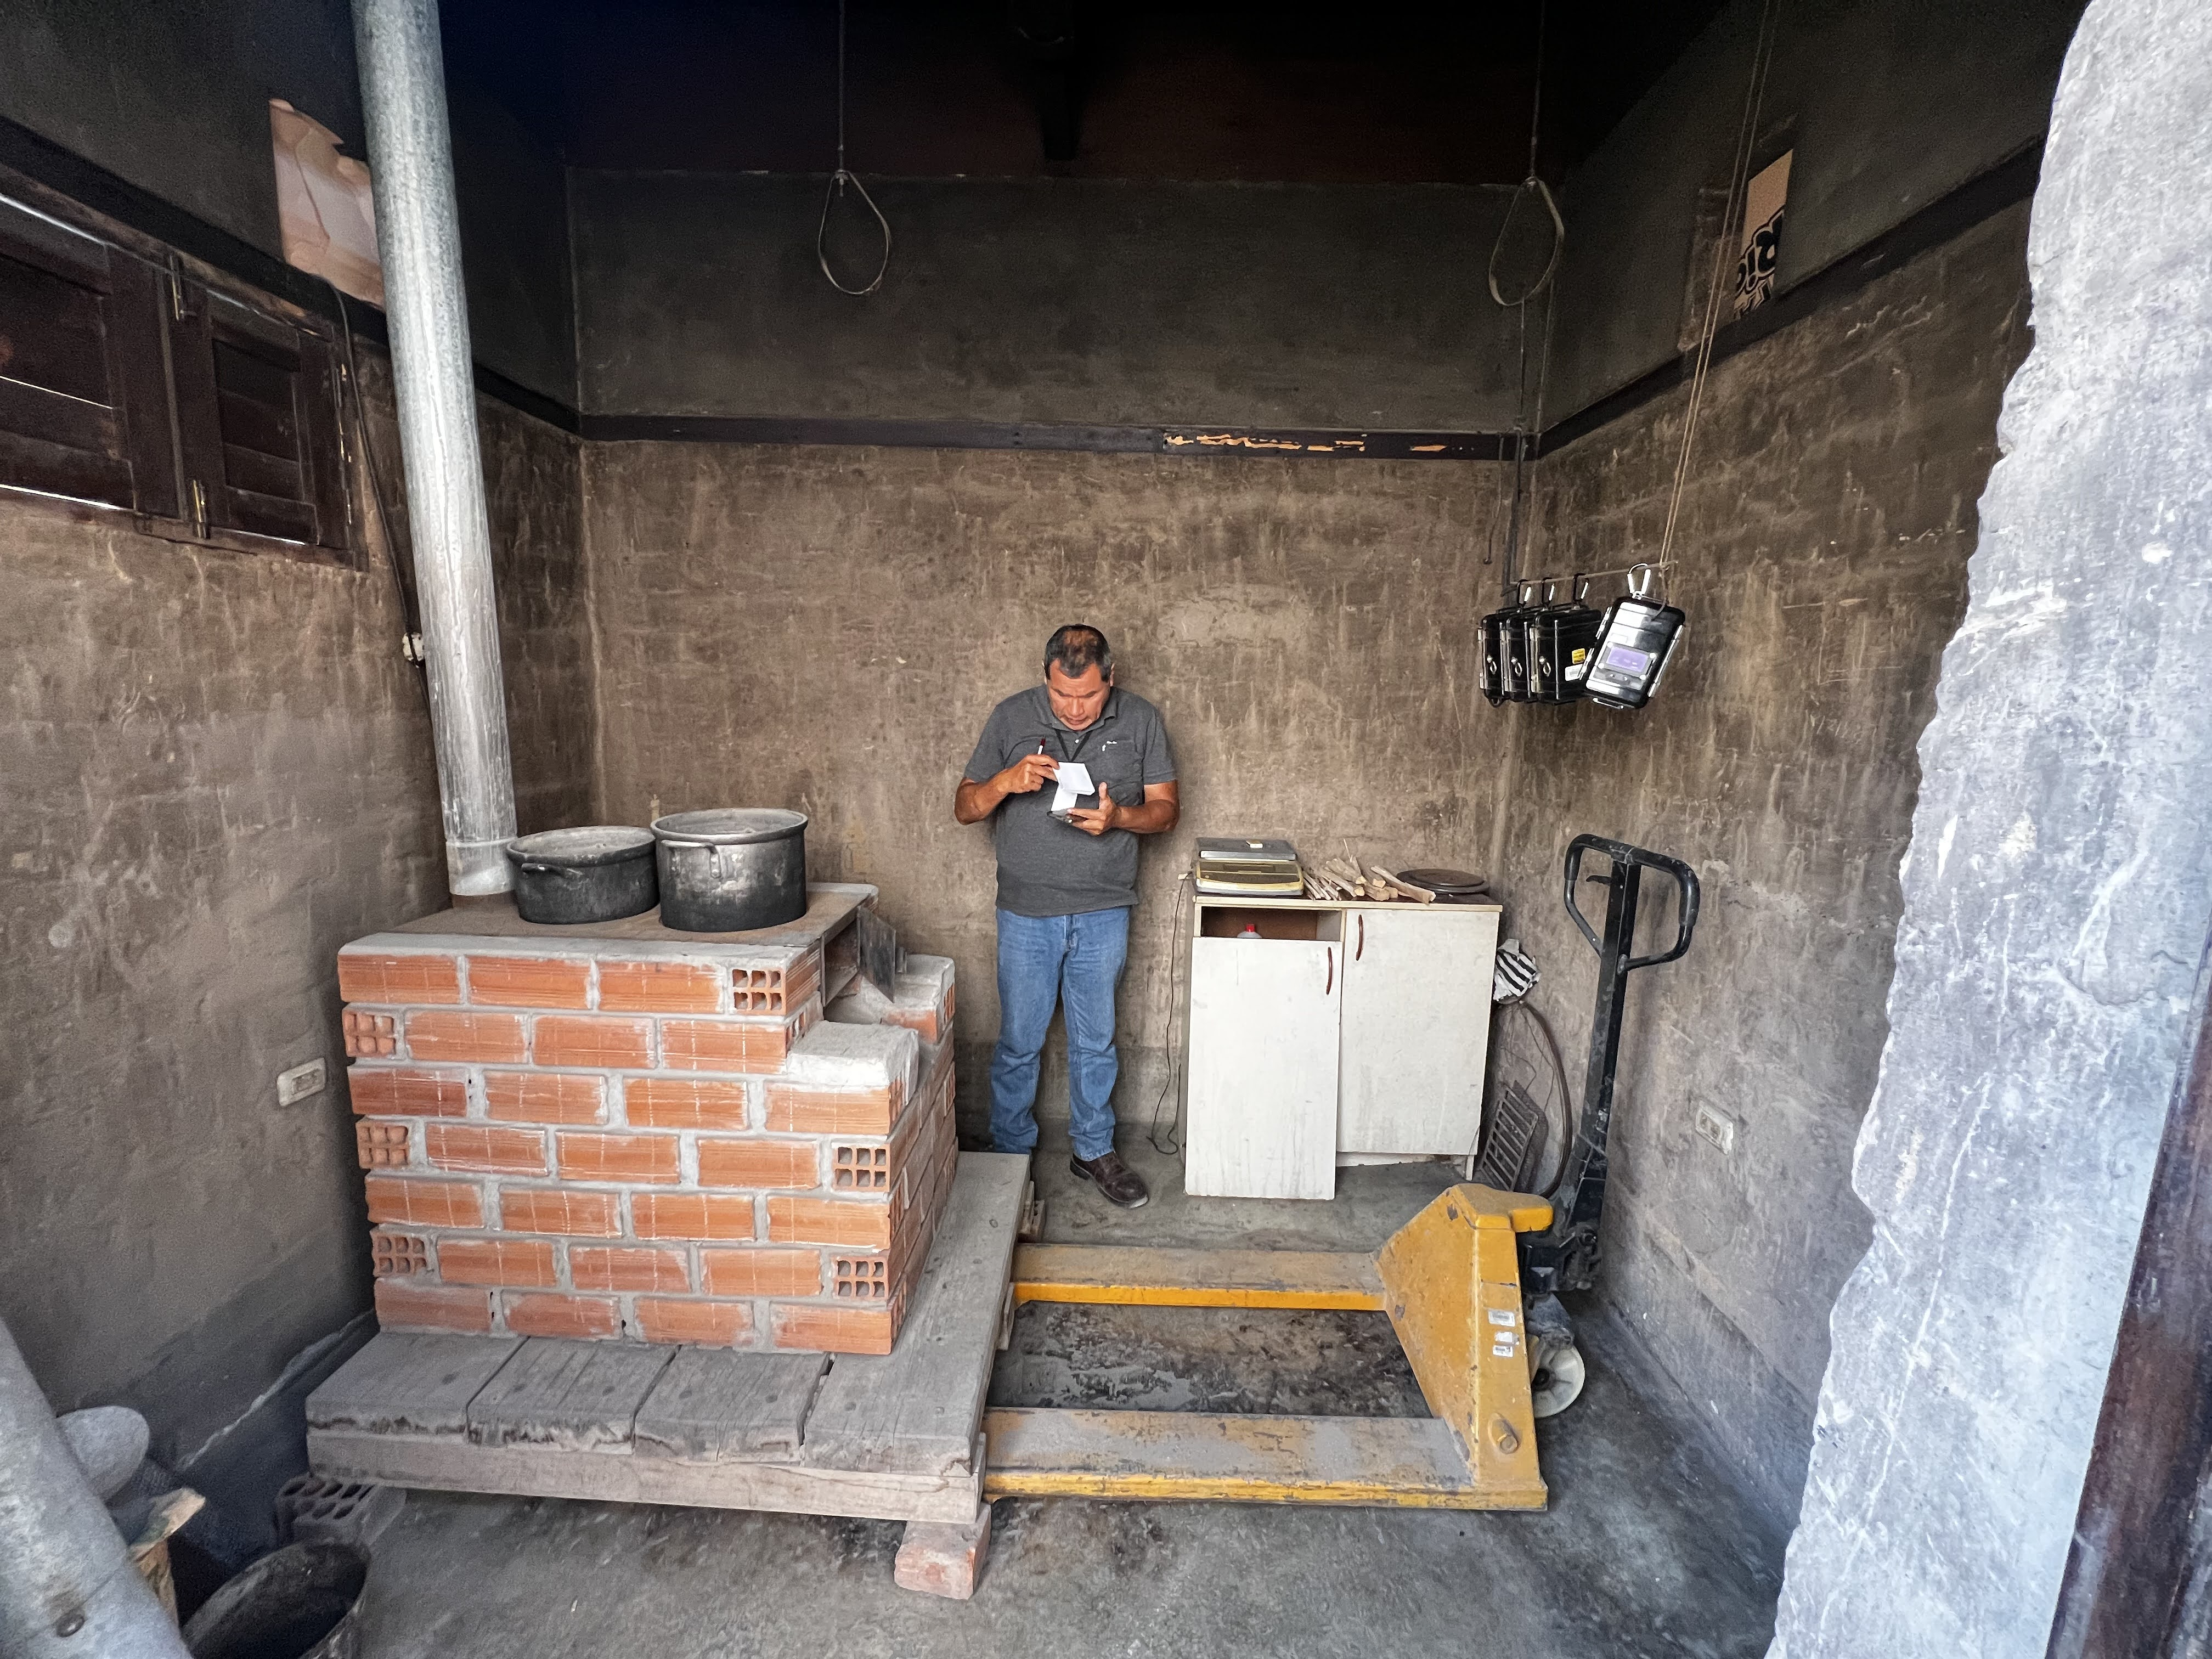
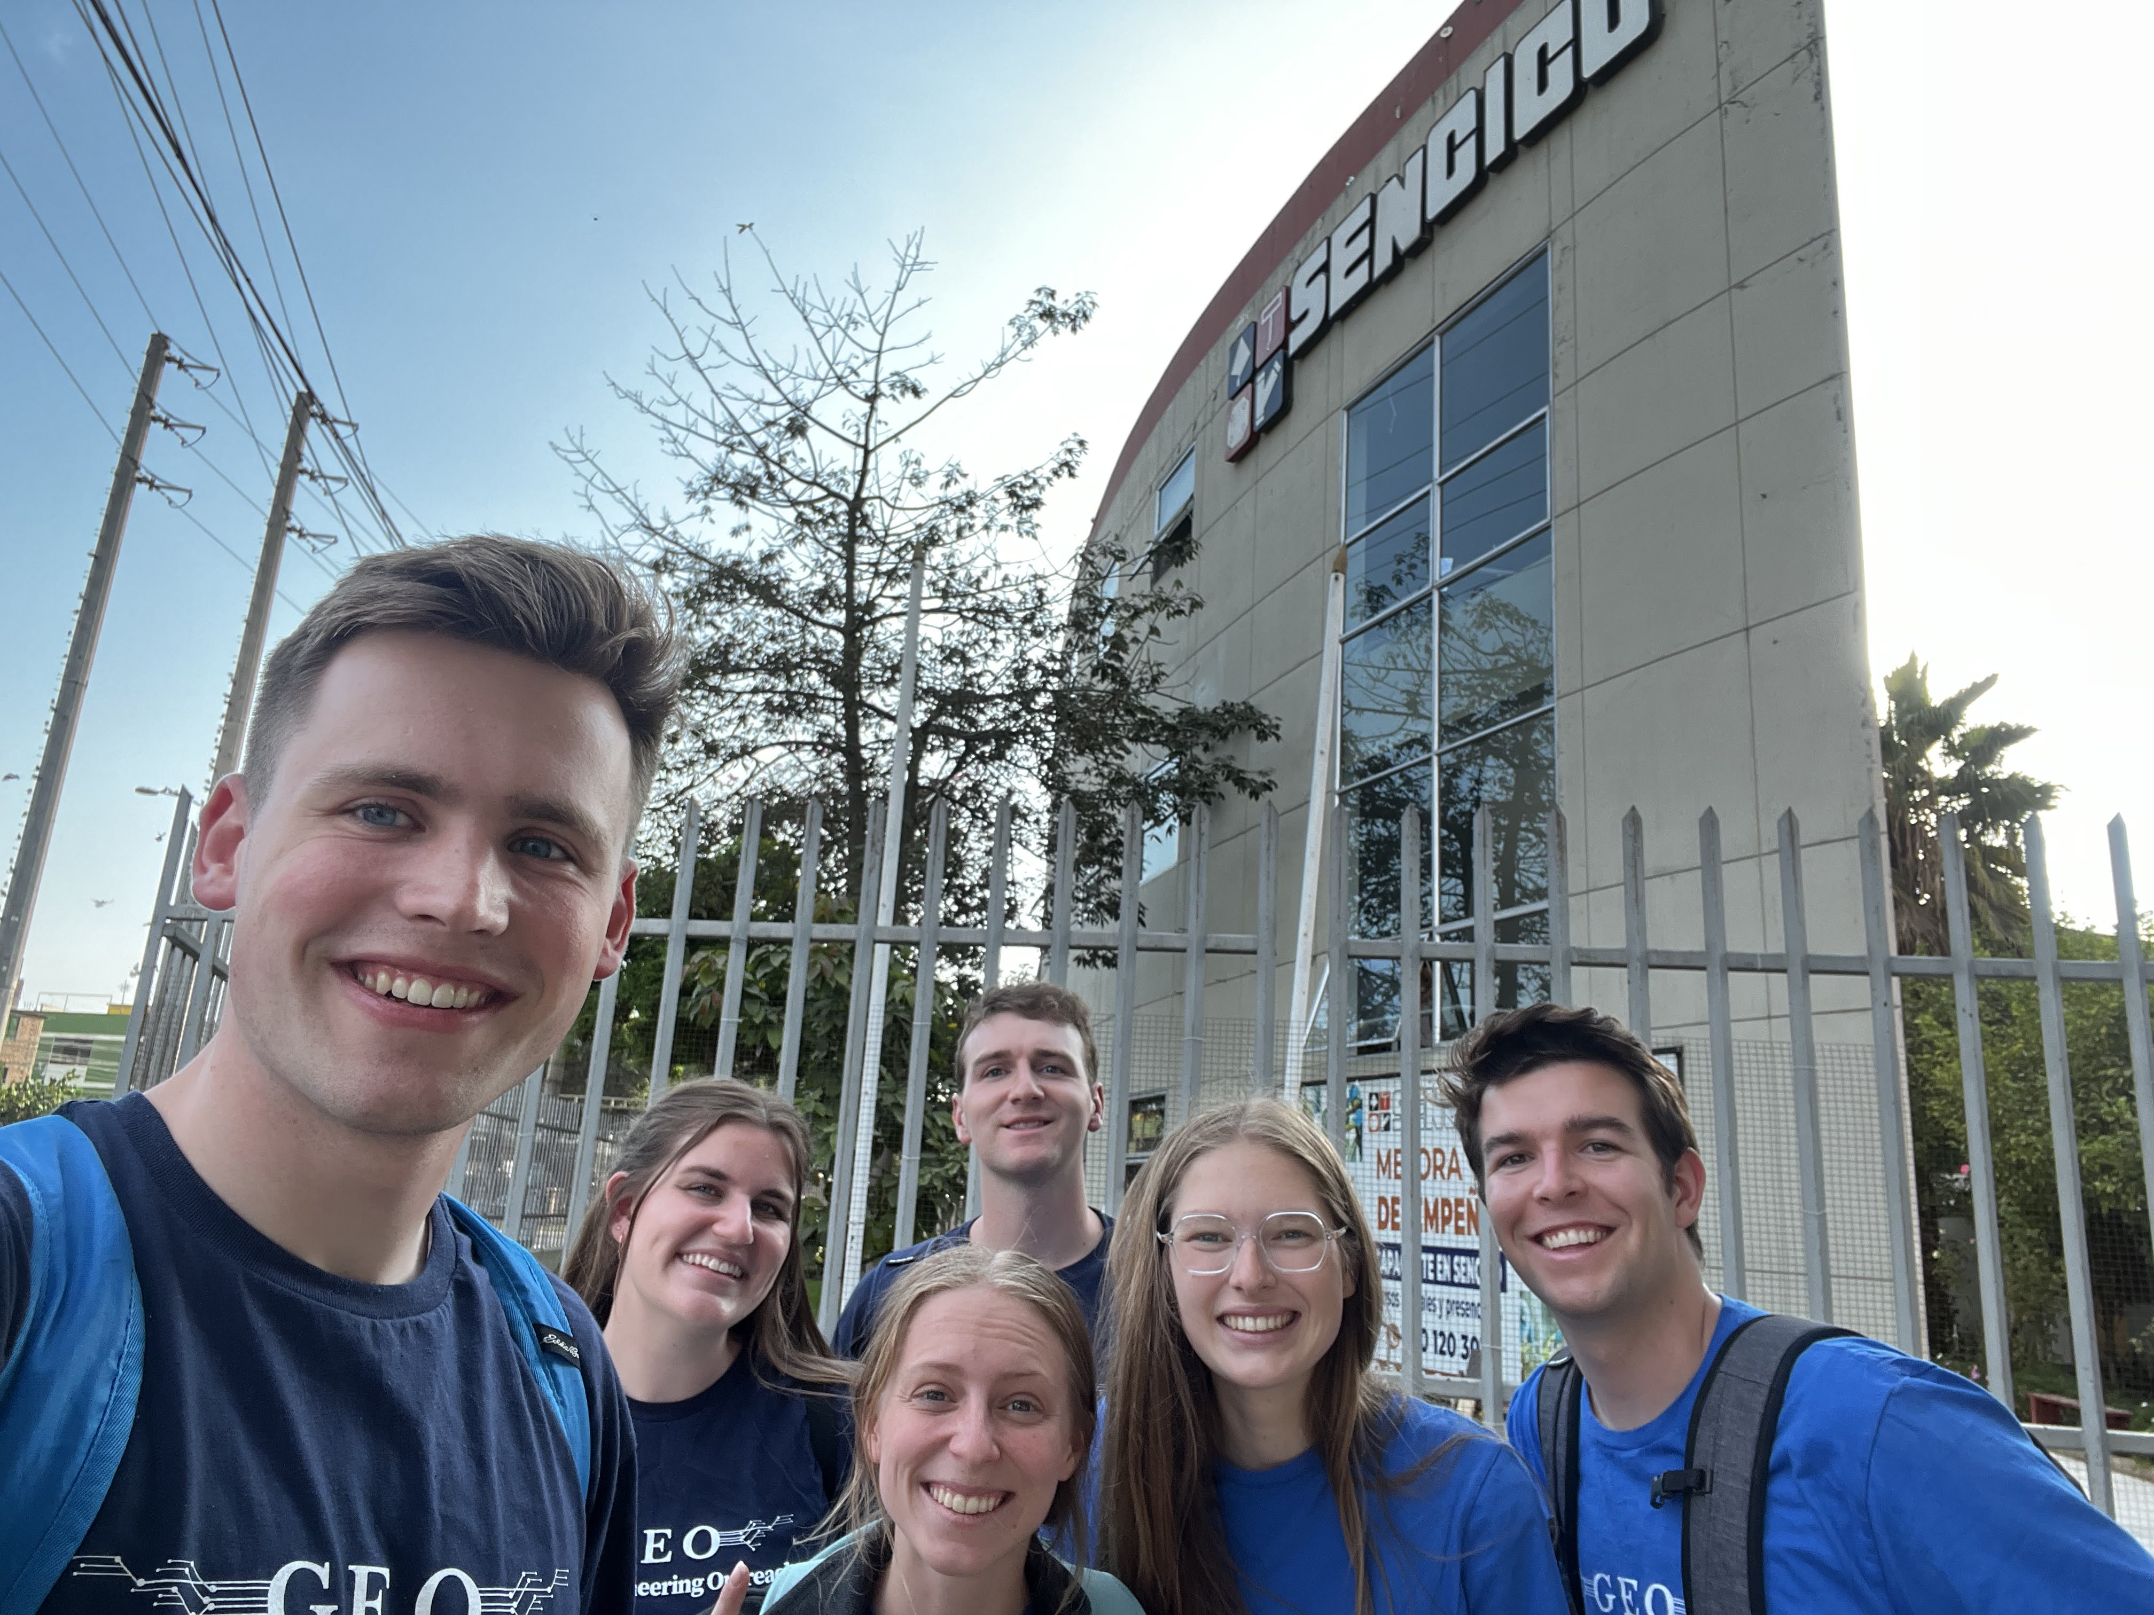
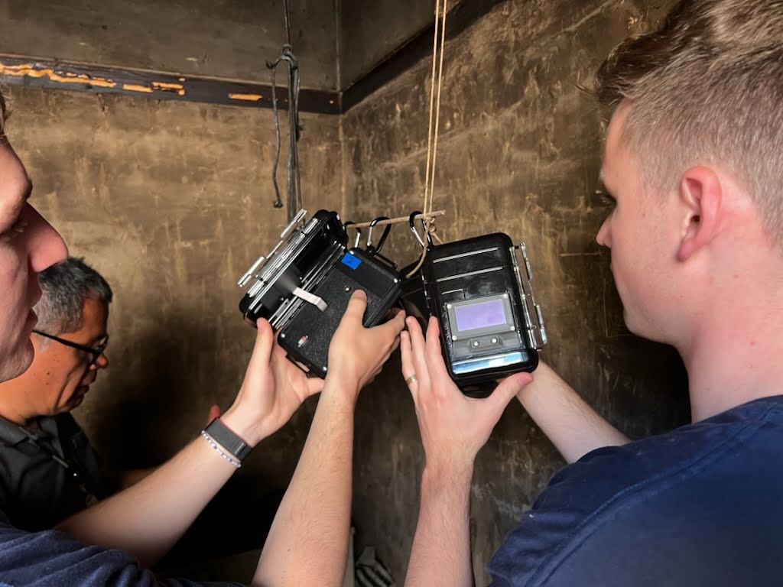
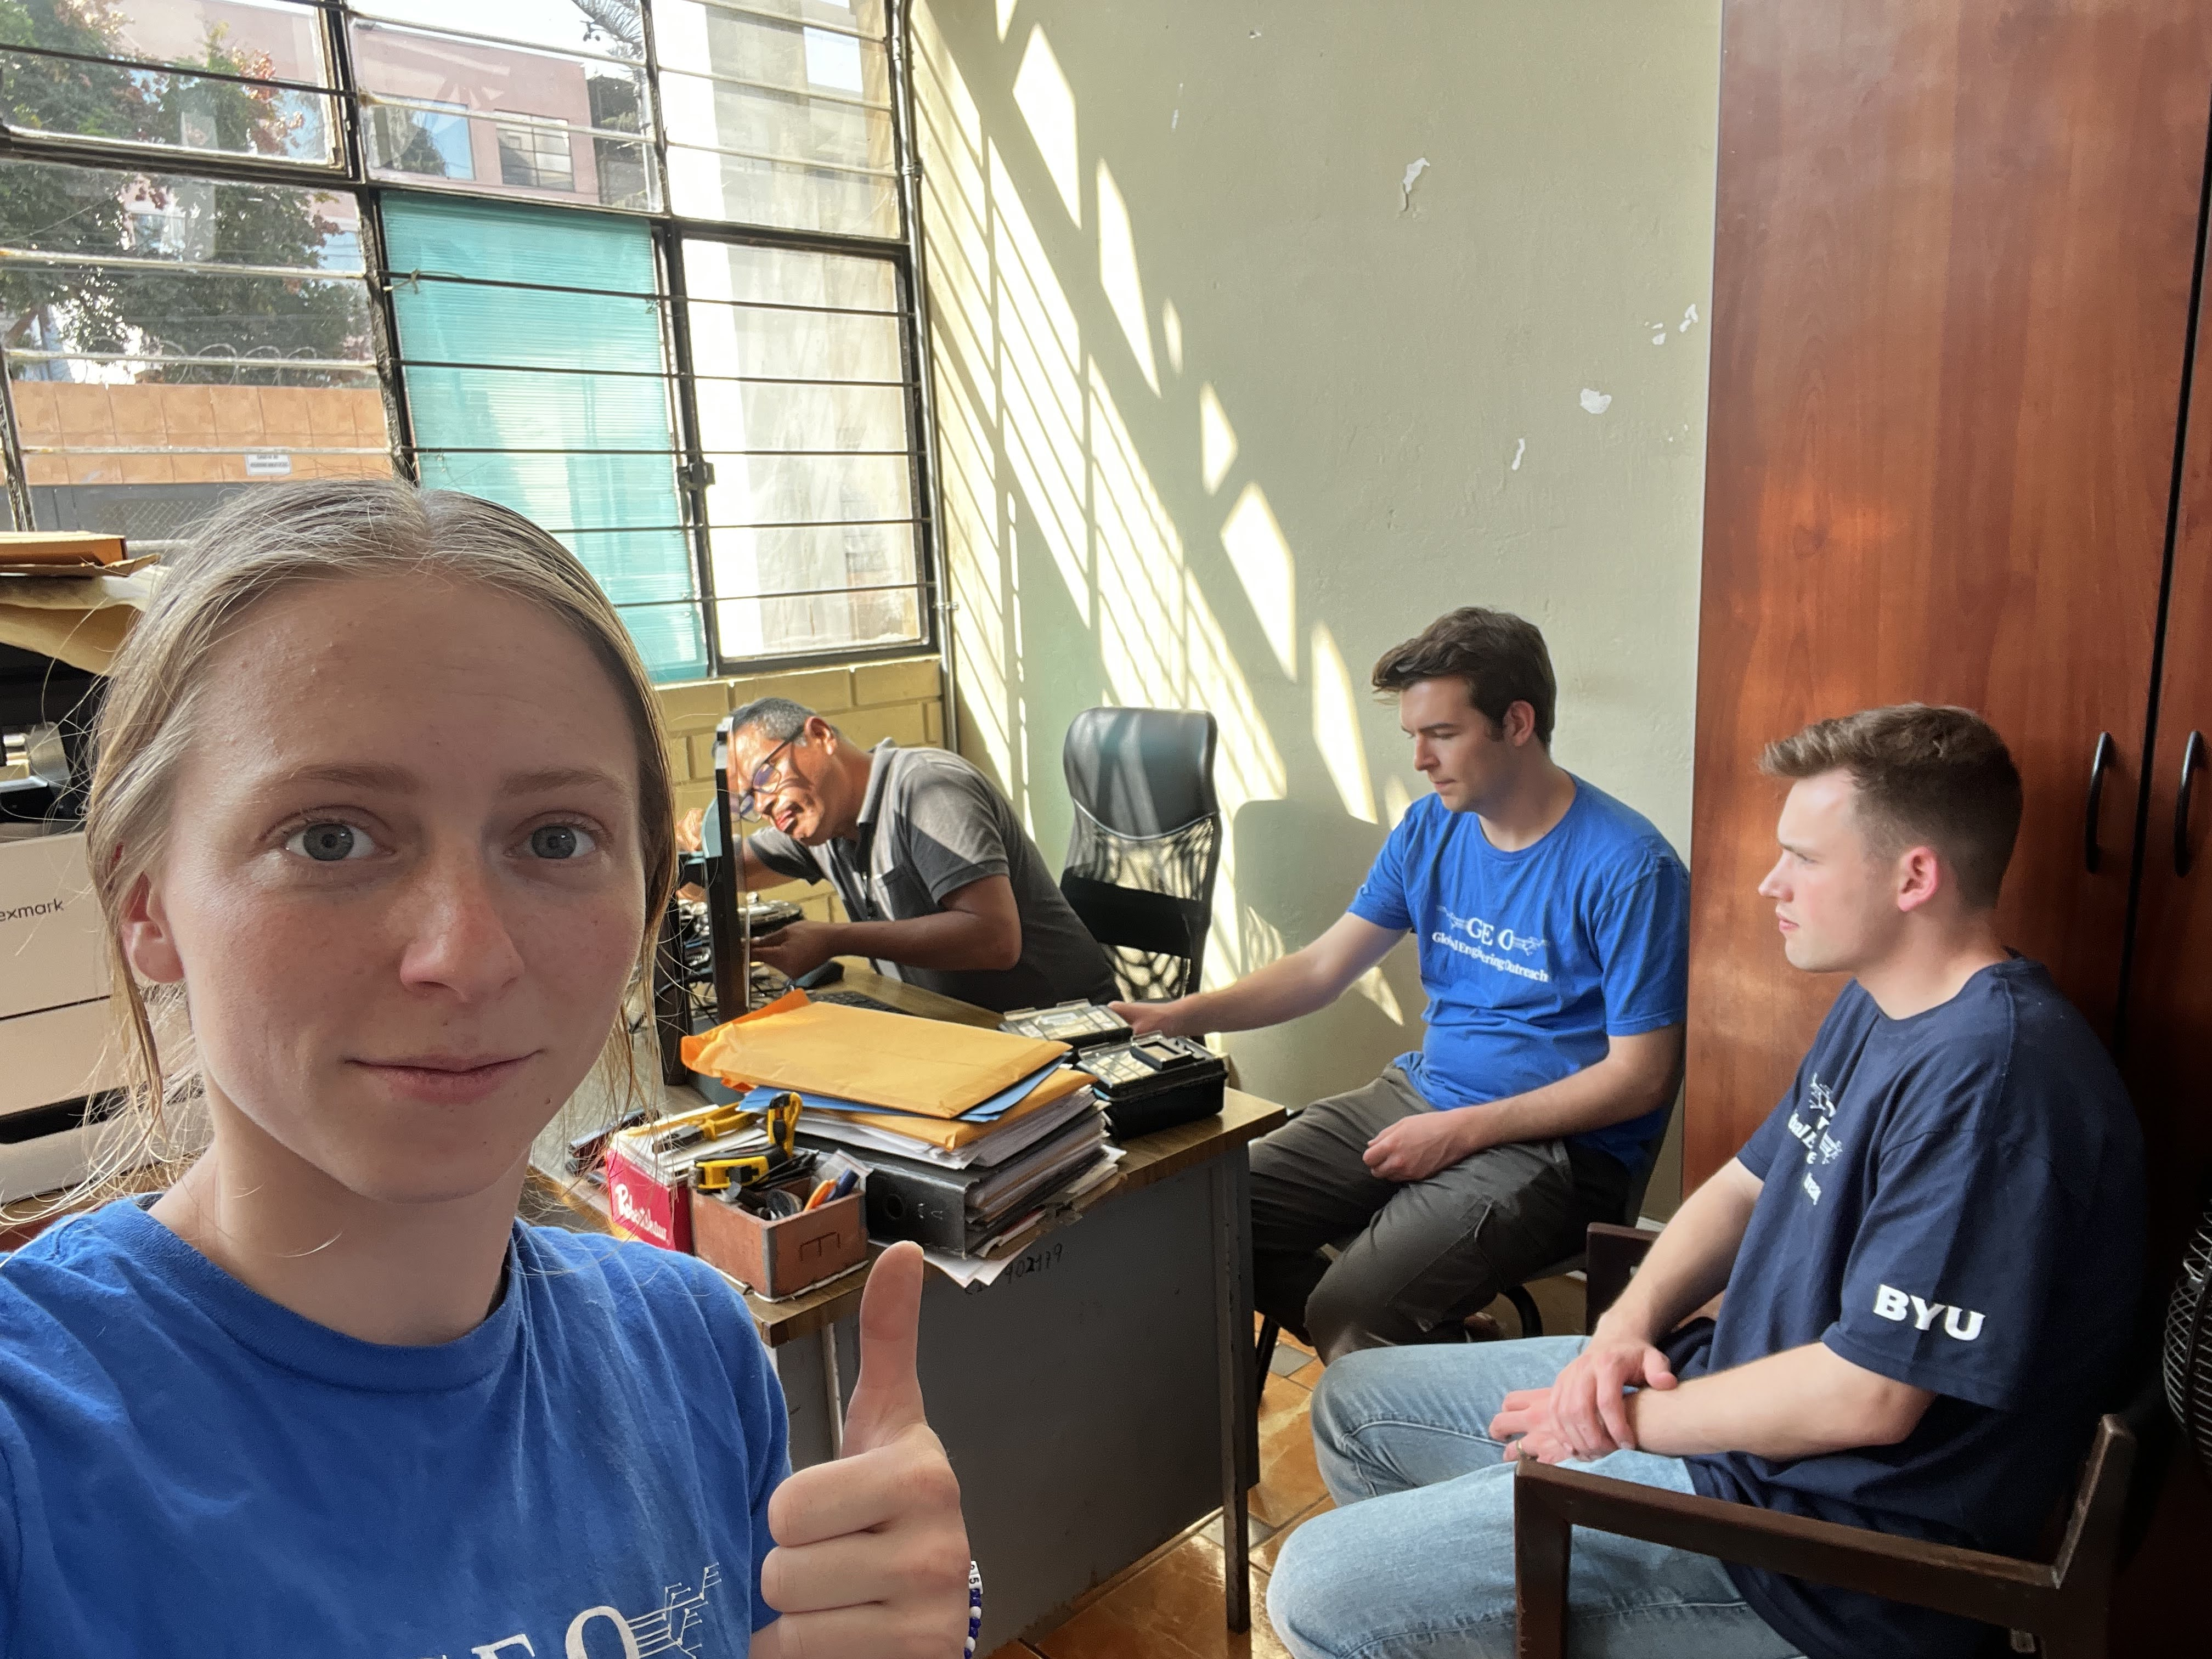
Pablo setting up another test with a real cookstove
Pablo and Taylor in the testing room showing the common three stone fire
The analysis of the data turned out great and SENCICO will recommend the BYU sensor to be their official company sensor.
Adam showing the screen on the BYU sensor design

